Slide 1



Apresentação Pessoal
André Aguiar
JANUARY, 06 2020 | SAO PAULO

Slide 2
Apresentação Pessoal
About me
Professional career
Inspirations
Some previous works
Some Kahoot
SQL recap
André Aguiar
JANUARY, 06 2020 | SAO PAULO

Slide 3

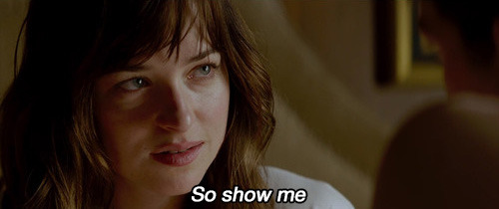
My desires are unconventional.

Slide 4
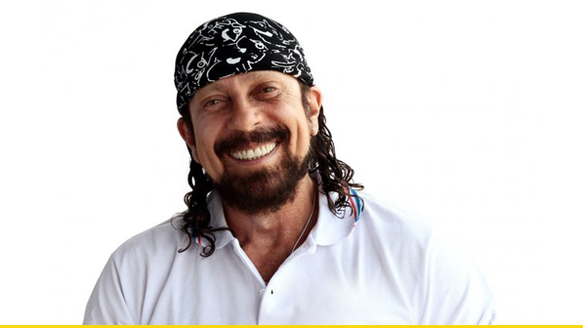

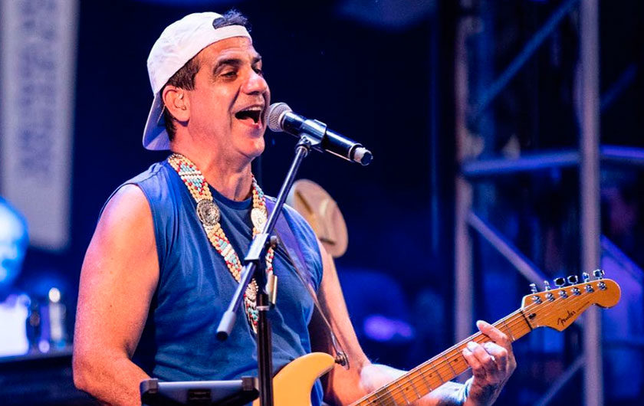

My desires are unconventional.

Slide 5

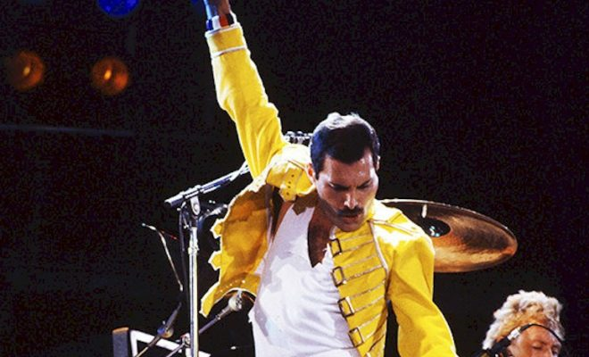
My desires are unconventional.

Slide 6
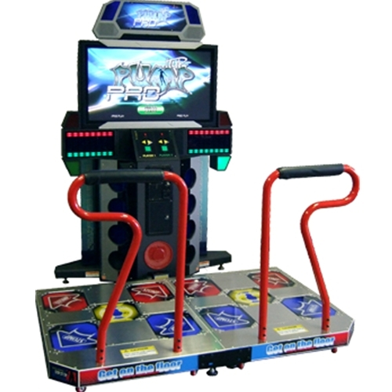





Hobbies.

Slide 7
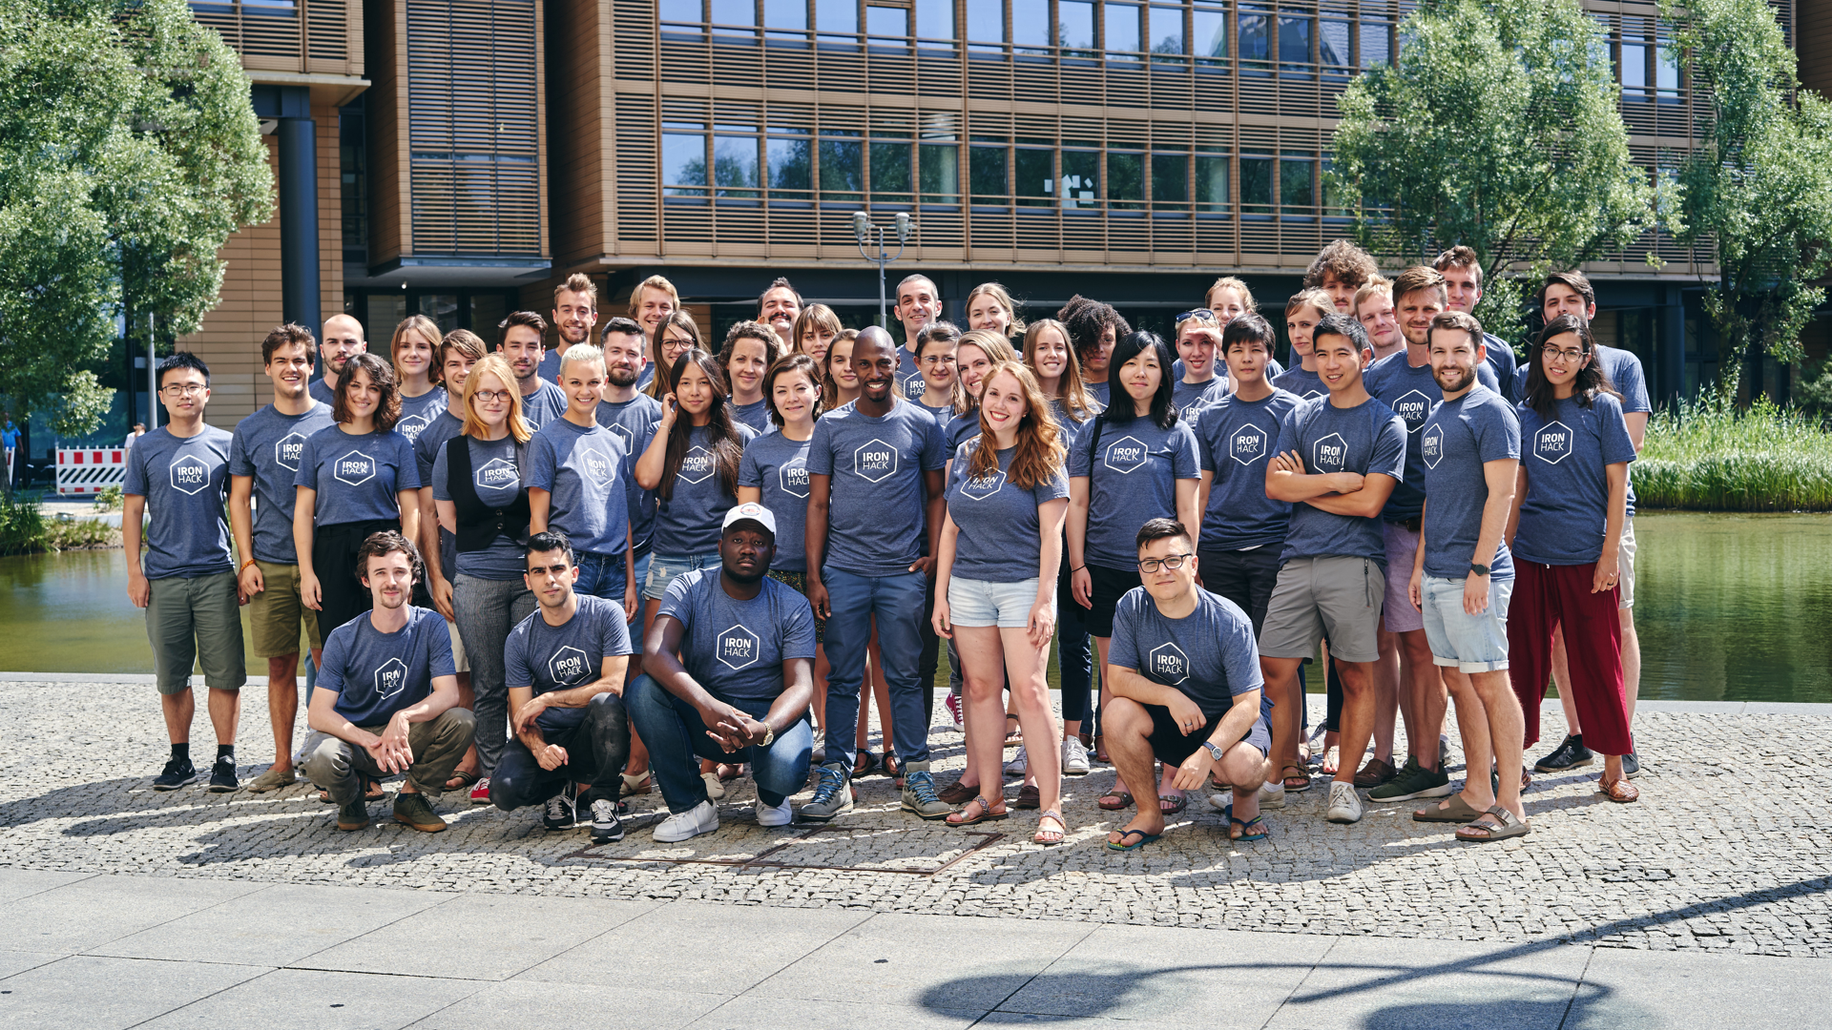

I AM A TRANSITION SLIDE
You can change the photo in the background!

Slide 8
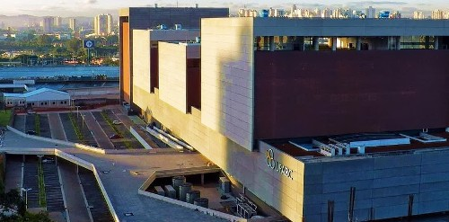
Professional Career
Aerospace
Engineer.

Slide 9
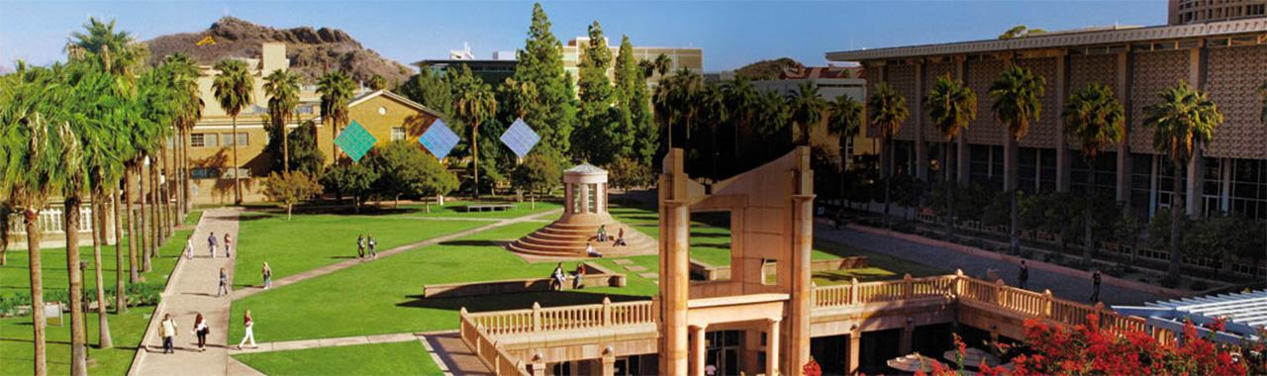
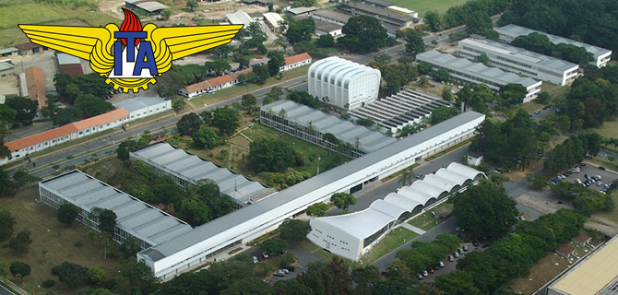
Professional Career

Slide 10
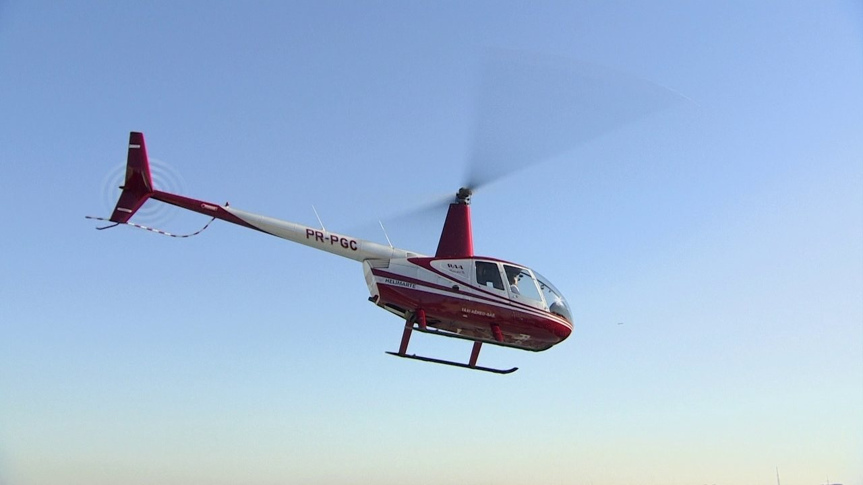
Professional Career

Slide 11

Professional Career

Slide 12



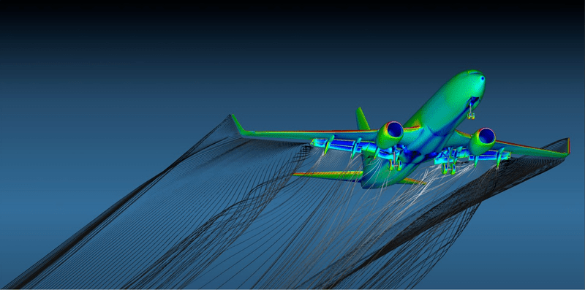

Professional Career
https://sites.google.com/site/andreaguiarcfd
https://fyfluiddynamics.com/

Slide 13




Professional Career

Slide 14
Professional Career

Slide 15
Professional Career
Center of Excellence (ACE)
Business infiltered

Slide 16
I AM ANOTHHER TRANSITION SLIDE
You can change the photo in the background!

Slide 17
Why Teach?

Slide 18

Why Teach?

Slide 19

Why Teach?

Slide 20

Why Teach?

Slide 21
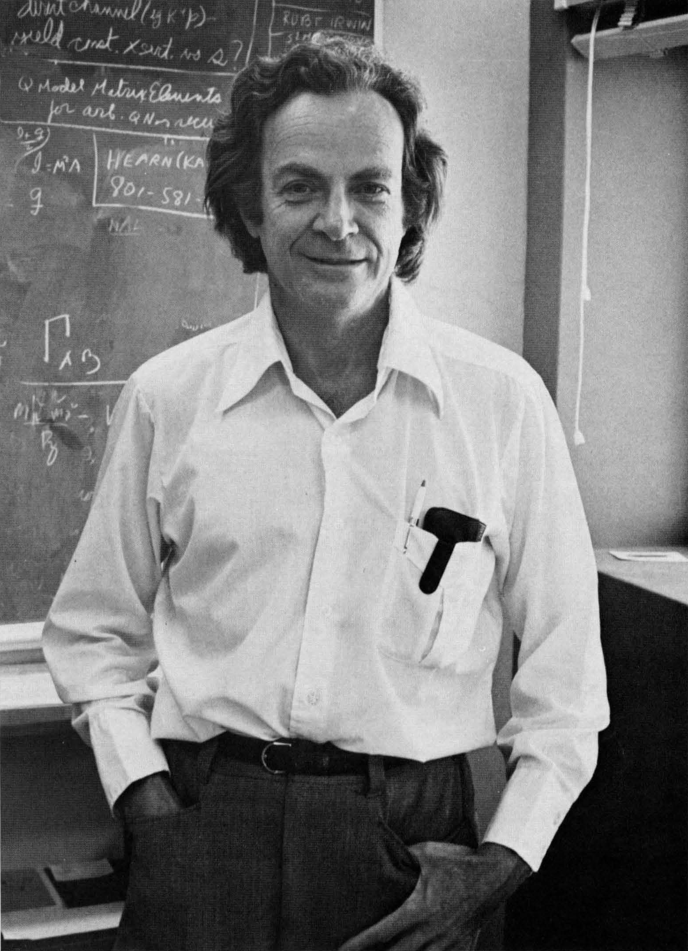
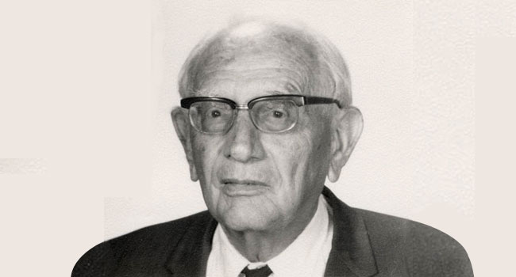


Inspirations
- Start strong
- Have something to say
- Say it well
- Stick to the landing
‘You may know the name of the bird in several languages, but still you know nothing about the bird’
‘At any rate avoid answering questions that nobody has asked, - not even yourself’
George Polya
Richard Feynman
‘How to solve it’
10 commandments for teachers
https://youtu.be/MO0r930Sn_8
https://newsvideo.su/tech/video/125028

Slide 22
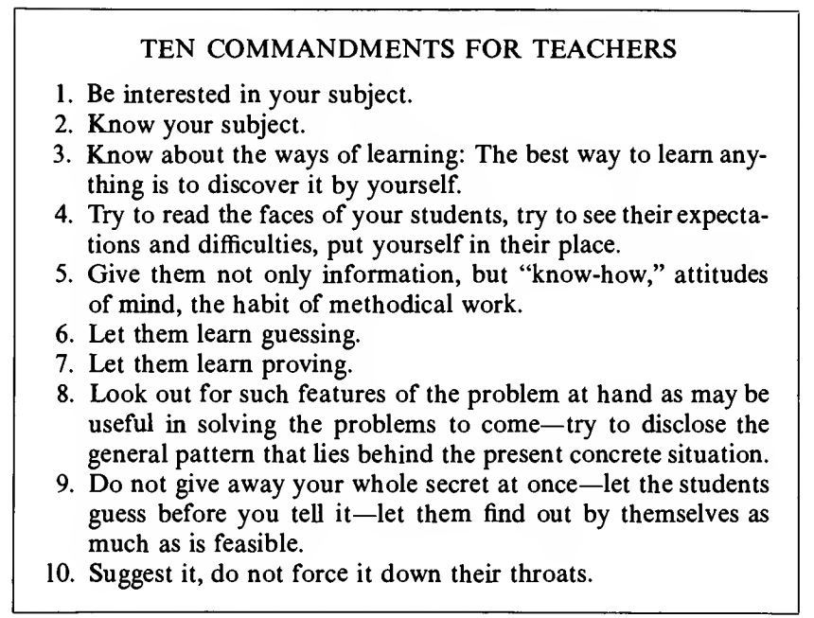
Inspirations
Polya

Slide 23


Inspirations
Ten Commandments for Teachers
#1 Be interested in your subject.
#2 Know your subject.
#3 The best way to learn is to discover yourself.
If the teacher is bored, students will be bored.
No amount of interest will enable you to explain clearly a point you do not understand.
No amount of interest will enable you to explain clearly a point you do not understand.
#6 First guess, then prove.
#8 The students should learn
by imitation and practice.
Educated guesses, not wild guesses
When solving a problem, emphasize the instructive features of the solution. A feature is instructive if it deserves imitation.

Slide 24
LAST TRANSITION SLIDE
You can change the photo in the background!

Slide 25
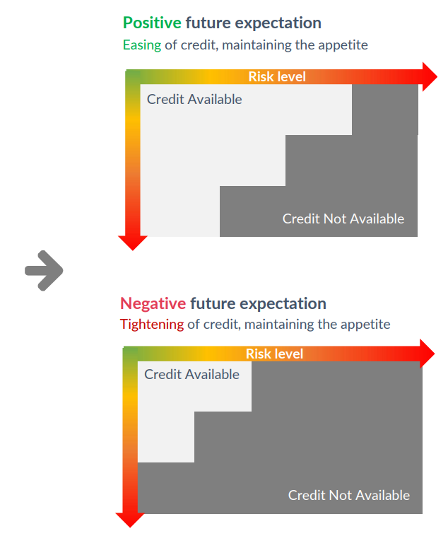
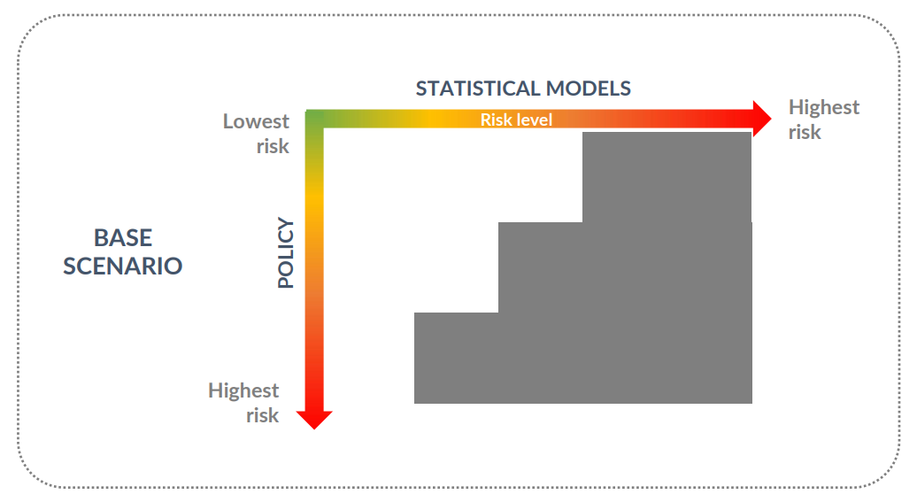
ITAU Business Overview
Retail Management of Individuals, Small, and Middle Companies

Slide 26
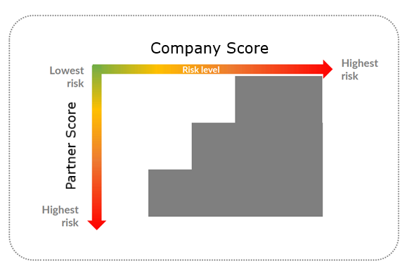
ITAU Business Overview
Retail Management of Individuals, Small, and Middle Companies

Slide 27
ITAU Business Overview
Retail Management of Individuals, Small, and Middle Companies

Slide 28
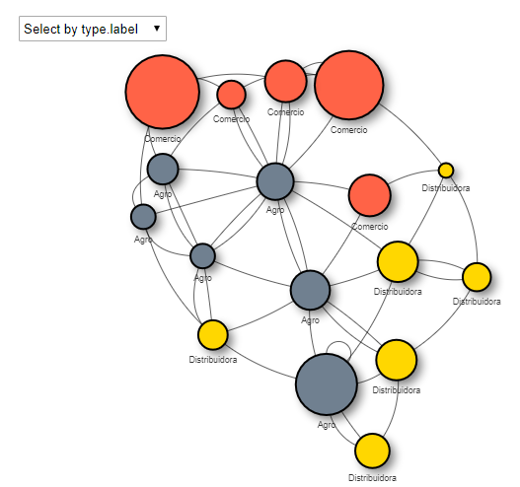
Applied Complex Network:

Slide 29
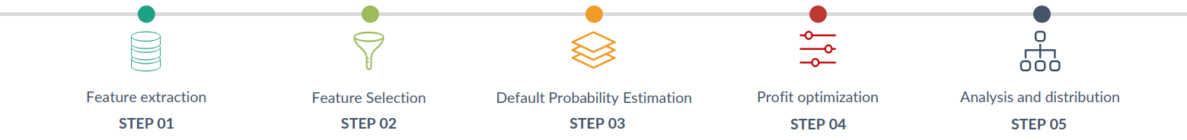
The development pipeline:
Database concept
STEP 01
Data Preparation
STEP 02
Complex Network Features Engineering
STEP 03
Machine Learning model development
STEP 04
Machine Learning model deployment
STEP 05

Slide 30
The development pipeline:
Database concept
STEP 01
Data Preparation
STEP 02
Features Engineering
STEP 03
Machine Learning model development
STEP 04
Machine Learning model deployment
STEP 05

Slide 31


